Slide 1

Web Application Firewalls (WAFs) — 2025 Overview
What a WAF is, how it works, deployment options, limitations, and how to complement it with runtime security (Oligo). Expert tips from Gal Elbaz included.

Slide 2



What Is a WAF?
Application-layer Defense
Blocks OWASP Risks
Flexible Deployment
Monitors, filters, and blocks malicious HTTP/HTTPS traffic to protect web apps, APIs, and mobile backends.
Defends against SQL injection, XSS, application-layer DDoS, and other common exploits.
Available as software, hardware appliances, or cloud services for integration into diverse infrastructures.

Slide 3
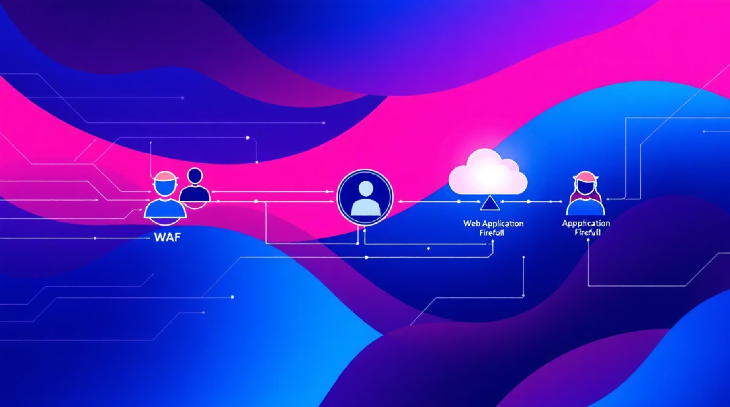
How a WAF Works
01
1. Traffic filtering
Intercepts requests as a reverse proxy and drops malformed or suspicious traffic.
02
2. Rule-based inspection
Applies signature, anomaly, or policy rules to detect malicious patterns.
03
3. Threat mitigation
Blocks, sanitizes, or challenges malicious requests to protect the application.
04
4. Customizable policies
Administrators tune rules to balance protection and legitimate traffic flow.

Slide 4


Detection Models & Modes
Signature-based
Matches known attack patterns (e.g., SQLi strings, XSS payloads).
Anomaly-based
Establishes baselines and flags deviations from normal behavior.
Policy-based
Uses manually defined rules tailored to application logic.
Modes
Detection (monitoring) logs only, or Prevention (blocking) actively stops threats.

Slide 5



WAF Deployment Models
Network-Based
Host-Based
Cloud-Based
Hardware/virtual appliance monitoring multiple apps. High throughput, centralized control, higher cost and complexity.
Agent/module on the server for fine-grained, app-aware protection—resource and operational overhead per host.
Security-as-a-service for fast deployment and scaling; relies on third-party operations and may raise residency concerns.

Slide 6
Key Features & Capabilities
Core Strengths
Bot Mitigation
Rate Limiting & DDoS
Custom Rulesets
OWASP protection, bot mitigation, rate limiting, customizable rulesets, centralized monitoring.
Behavioral analytics, CAPTCHA, device fingerprinting, and rate limits to curb automated abuse.
Throttle abusive traffic and integrate with scrubbing to defend availability.
Tailor policies for app-specific logic and reduce false positives.
Visibility
Unified logs and dashboards; integrate with SIEM for correlation and forensics.

Slide 7

WAF Limitations
Limited protection vs novel zero-day, highly obfuscated attacks.
False positives/negatives require continuous tuning and expertise.
Performance overhead—deep inspection adds latency and resource cost.
Bypass risks from misconfigurations or alternate entry points.
Struggles with complex business-logic attacks.
Operational complexity: upkeep, updates, and alignment with app changes.

Slide 8
Best Practices for Secure WAF Configuration
Customize Rulesets
Tailor rules to app behavior; coordinate with developers to avoid disruption.
Regular Security Testing
Pen tests and automated scans validate WAF effectiveness after changes.
Enable Logging & Alerting
Detailed logs and SIEM integration support incident response and threat hunting.
Routine Policy Updates
Sync policy reviews with release cycles and threat intelligence feeds.
Integrate Runtime Context
Fuse WAF telemetry with runtime signals to prioritize real compromises over probes.

Slide 9
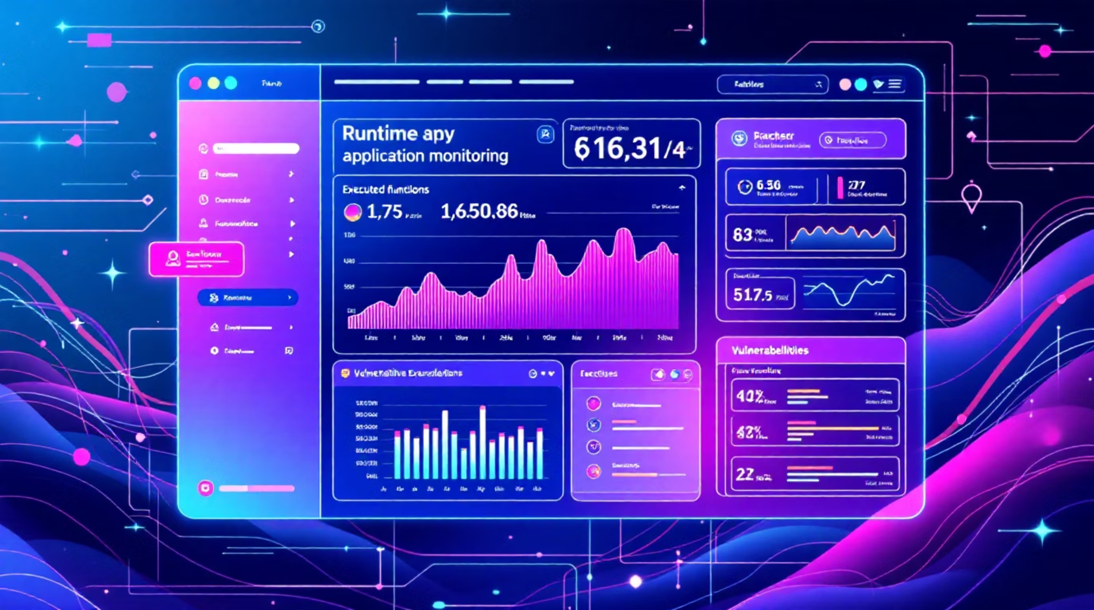

Complementing WAF with Oligo Runtime Security
Oligo augments edge protections by revealing whether attacks reached vulnerable code or triggered execution. Combining WAF blocking with runtime visibility reduces time wasted on false positives and focuses teams on genuine threats.
Deploys in minutes for modern cloud apps (K8s) and legacy on-prem systems.
Book a Demo

